Slide 1
Life Coach
Patrick Zambri, Bradford Harris, Marisa Proscia, Chris Siena, Jacob Levinson

Slide 2

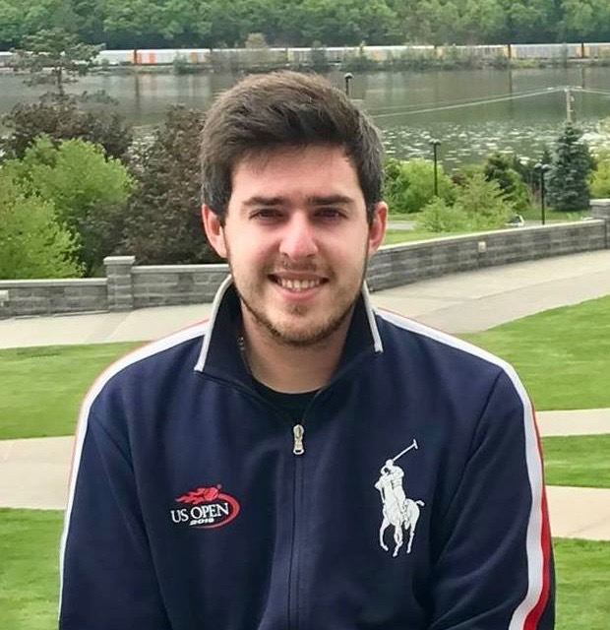

Team Pictures

Slide 3
Project Status
 | Schedule | We are adhering to our development schedule.
 | Technical | We are developing our database and server. We are also working on designing prototypes for our desktop and mobile sites. Problems with SSH and server
 | Resource | We currently have outstanding client questions.
 | Other | N/A

Slide 4
Project Progress
Accomplishments
Completed Homework 3
UI Wireframes
Revamp Homework 1
Use Case Diagrams and Documentation
Update Project Plan
Update User Requirements
Activities being worked
Server setup, website design prototyping, database setup

Slide 5
Scope of Project
What it is | What it is not
A website and mobile application | A desktop application

Slide 6
Schedule
Week | Requirements | Development | Testing | Members
5 | Begin work on basic functionality of website and features Homework 3 due | Finalize website UI mockups. Compare mockups to client specifications. |  | Marisa, Jacob, Chris Brad All
6 | Final Project Plan & UML Diagrams | Ensure team is staying on track with plan while providing realistic expectations to the client and constantly updating Project Plan. Finalize Project Plan based on updates and instructor feedback. Finalize UML Diagrams. Continue work on website functionality and features. |  | Brad Patrick Marisa, Jacob, Chris
7 | Database Design Draft Due | Create database design draft. Implement database design standards to draft. |  | All
8 | Initial Peer Reviews Due | Individually Complete first round Peer Reviews. Revisit database architecture and prepare prototype for production. | Test overall website functionality. | All Chris, Marisa, Jacob
9 | IT Requirements Draft Due | Revisit database architecture and prepare prototype for production. Team meeting to finish draft of IT requirements & network design. |  | Chris, Marisa, Jacob Brad,Patrick
10 | Complete Database Prototype Homework 4 Due | Complete Database Prototype. Ensure work is being completed on time in order to be ready for the demo in week 11. |  | Chris, Marisa, Jacob Brad All
11 | Demo of Prototype prepared | Provide a demo of a functioning prototype website. |  | All

Slide 7
Project Risks
Risk | Score | Mitigation
Time .. Nothing new | High | Keep working.

Slide 8
Project issues
Issue | Owner | Action Plan | Checkpoint Date
Problems while trying to SSH Into server | Pat

Slide 9
Lessons Learned
Lessons Learned | Corrective Action / Recommendation
No new lessons.

Slide 10
UI Wireframes

Slide 11
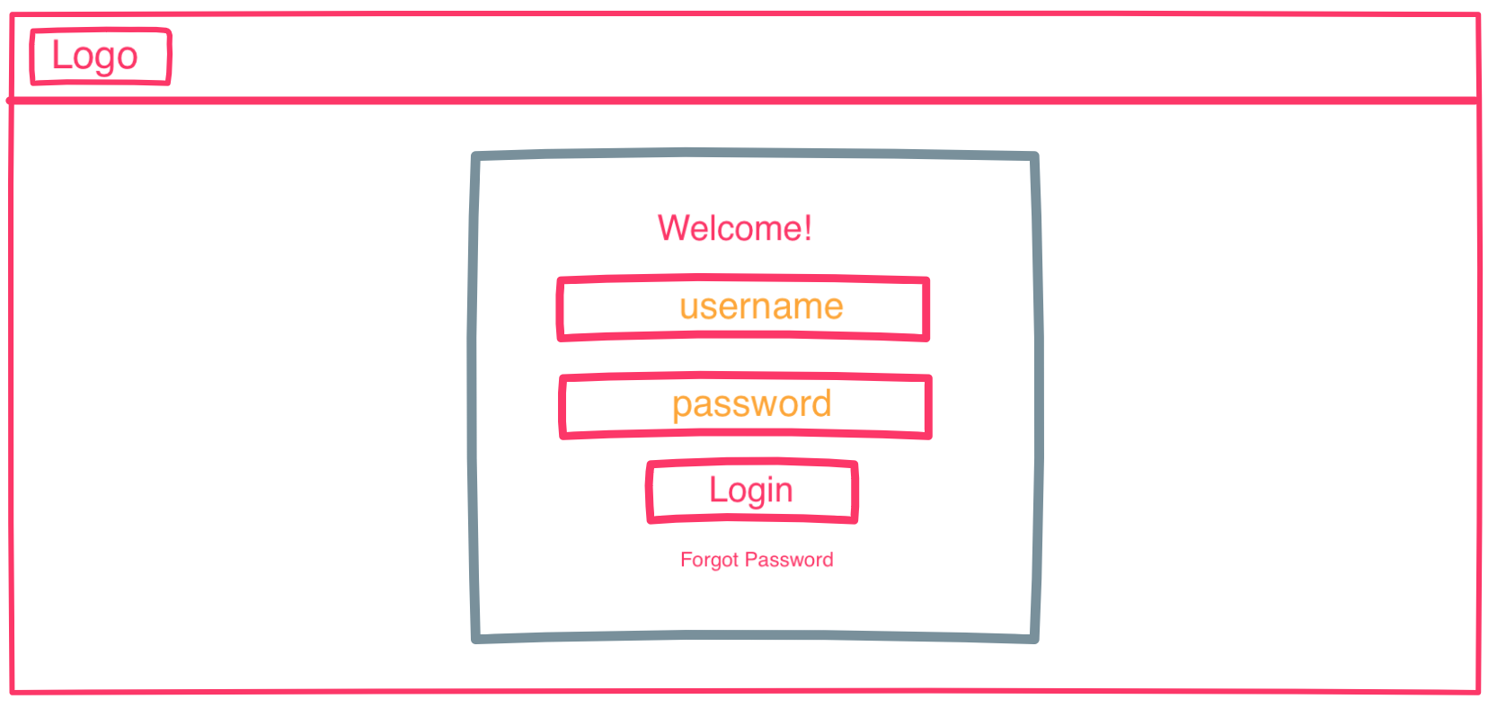
Login Screen - Desktop

Slide 12
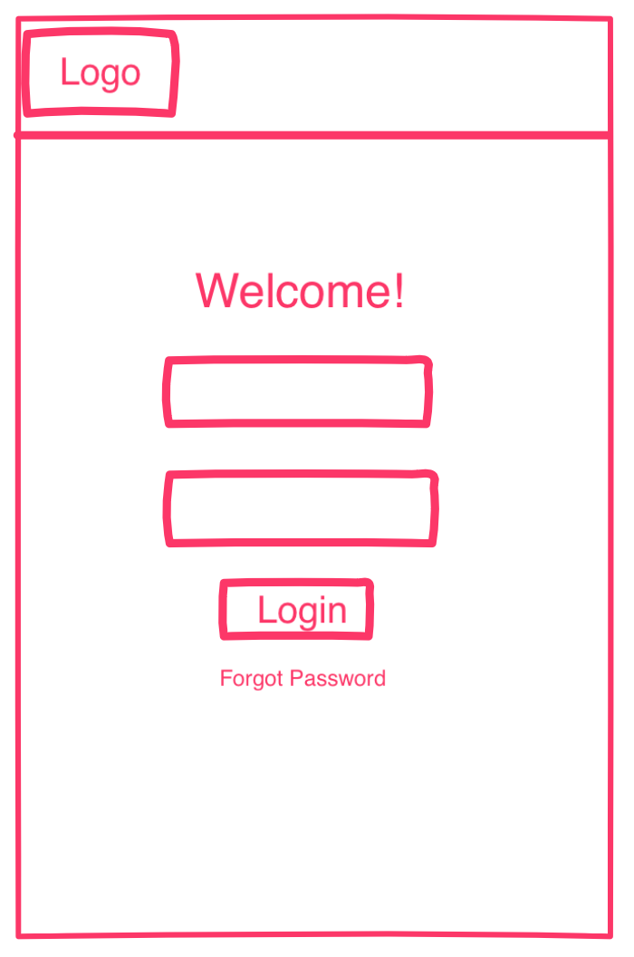
Login Screen - Mobile

Slide 13
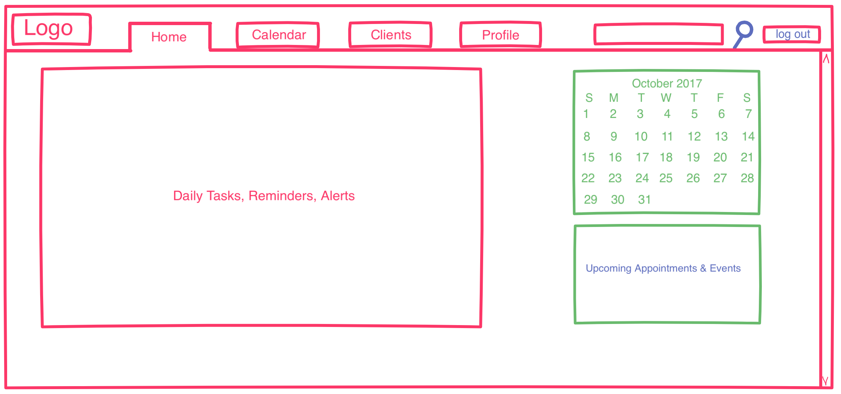
Homepage - Desktop

Slide 14
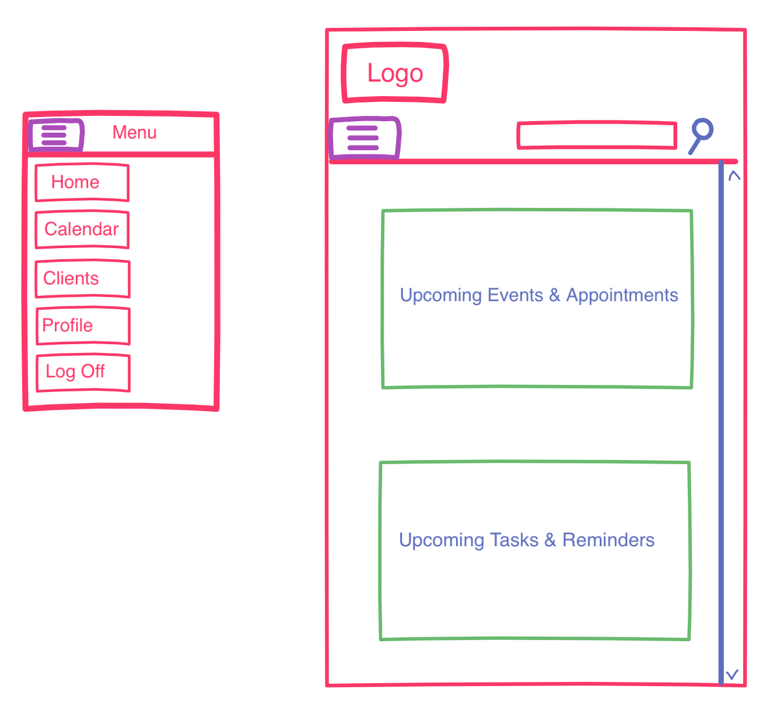
Homepage - Mobile

Slide 15
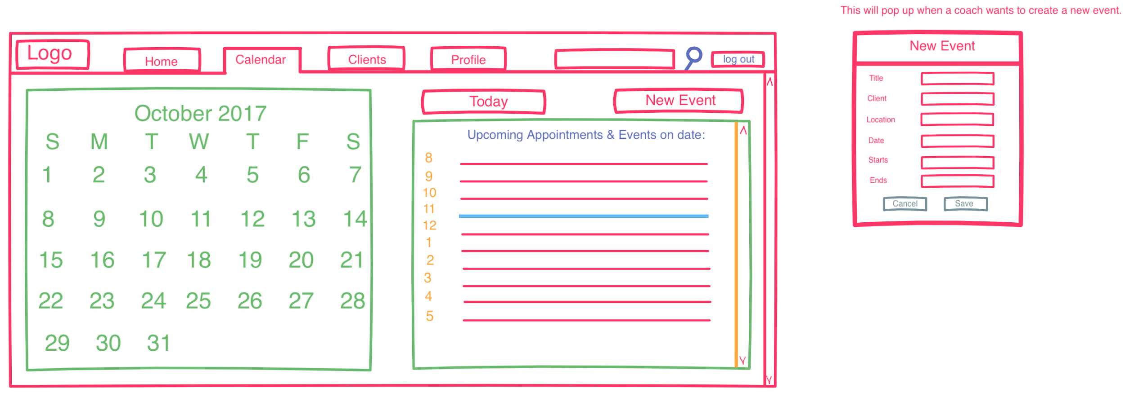
Calendar - Desktop

Slide 16
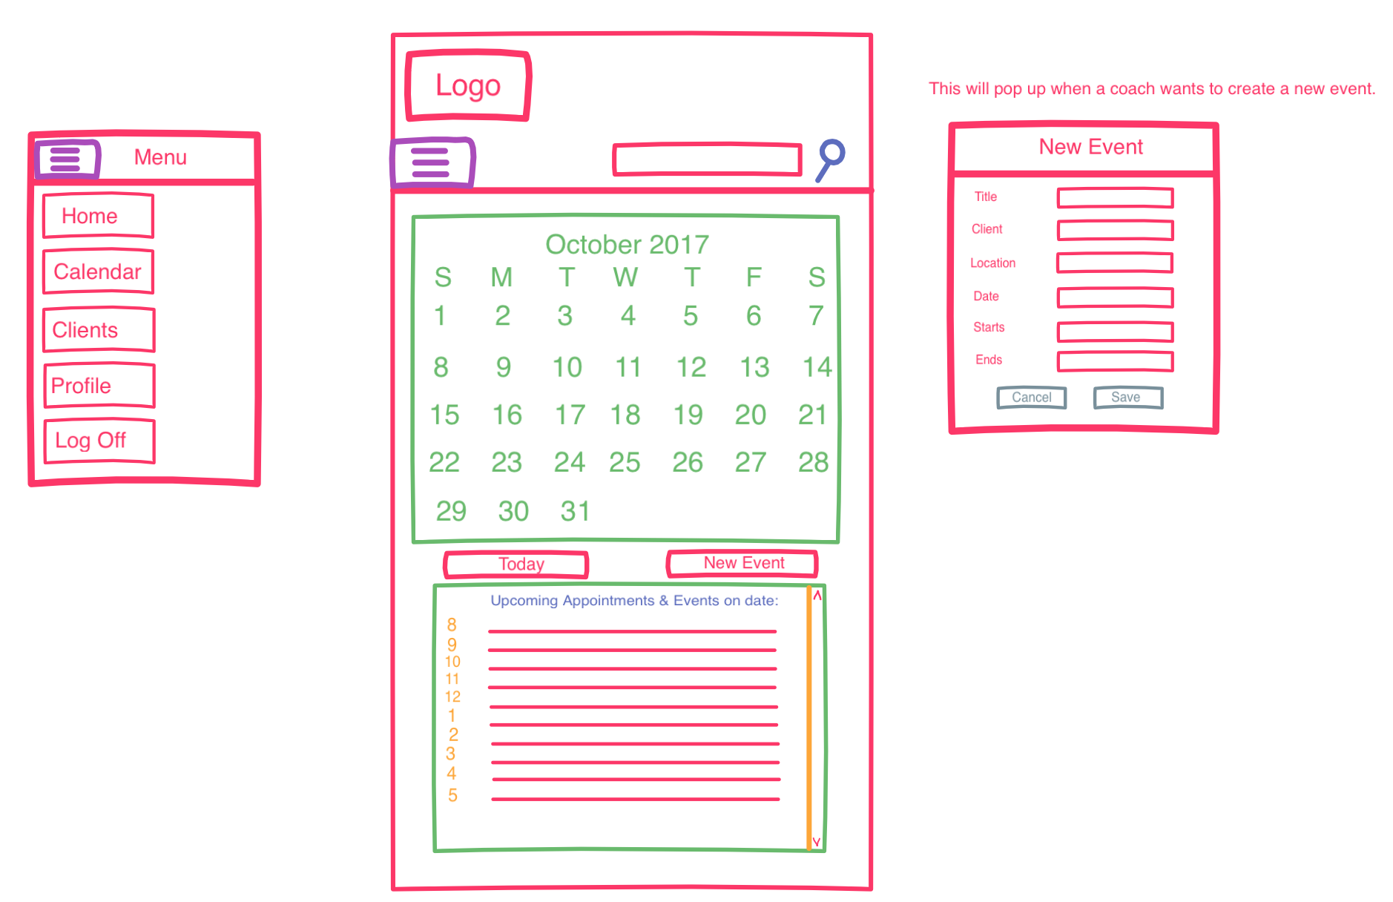
Calendar - Mobile

Slide 17
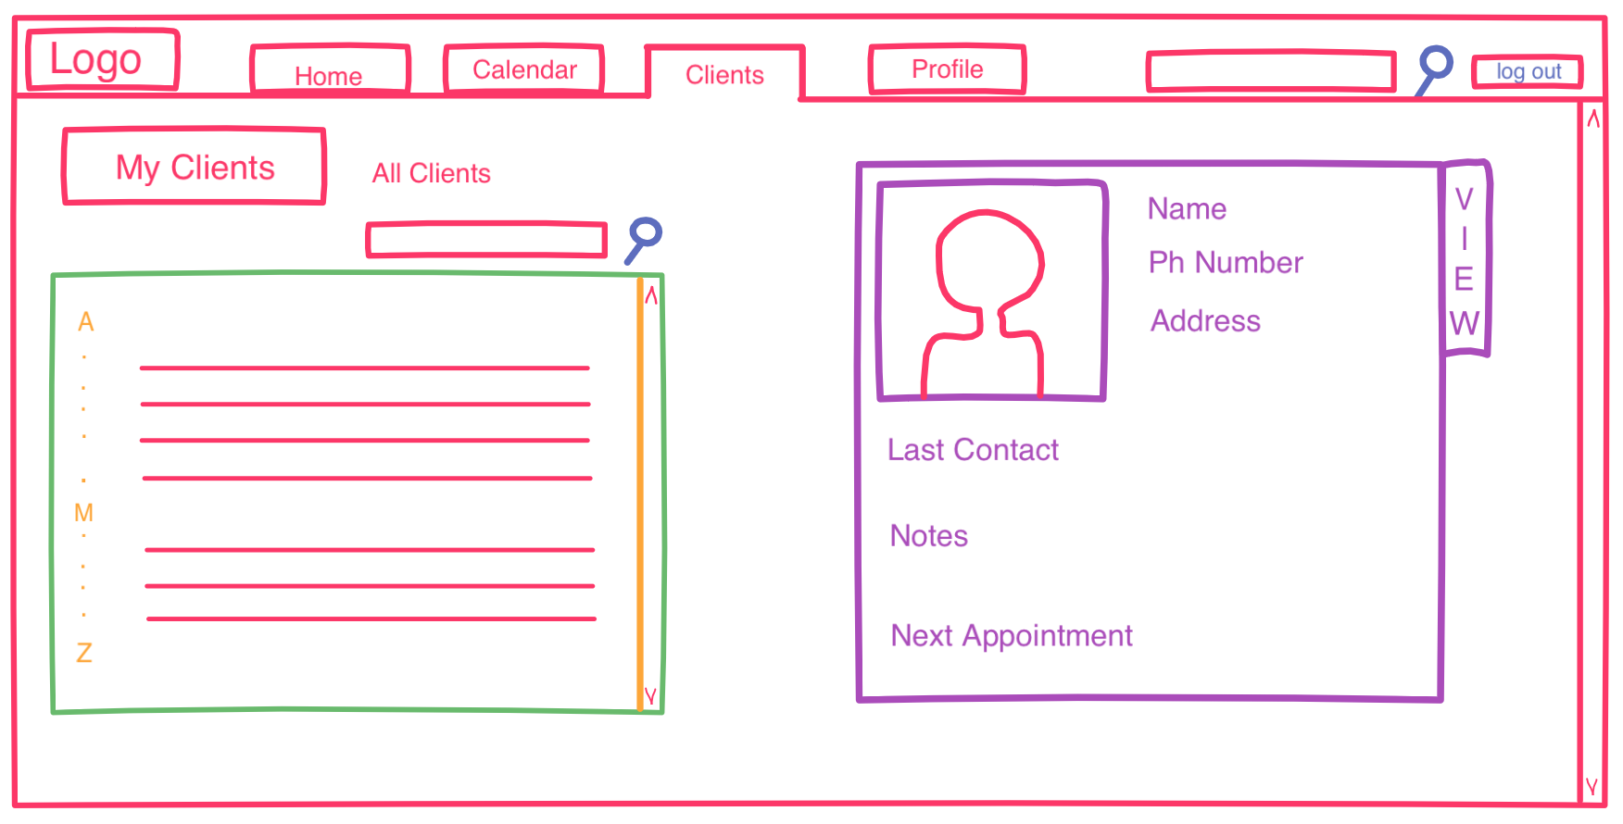
Client - Desktop

Slide 18
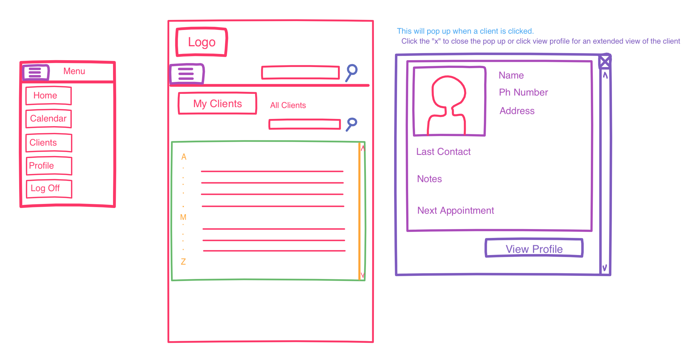
Client - Mobile

